Slide 1


Module 4: Generative AI
Deepak Subramani
Assistant Professor
Dept. of Computational and Data Science
Indian Institute of Science Bengaluru

Slide 2
Outline for Jan 25
Part 1: Decoder only GPT Model
What are GPT-class Generative Large Language Models
Data preparation for GPT model training
GPT finetuning (Assignment)
Part 2: LLMs and Interacting with them
Commercial and open source LLMs
What are the main issues in LLMs to be aware of?
Taxonomy of interaction with LLMs
Prompting Strategies – ZSL, FSL, CoT, ReACT, DSP
Parameter Efficient Fine Tuning (LoRA, QLoRA)

Slide 3
Outline for Feb 01
Part 1:
Instruction Tuning
Part 2:
Orchestration
Retrieval Augmented Generation
Part 3:
LLM Guardrails
LLM Agents

Slide 4
List of Prompting Strategies
Chain of Thought Prompting (CoT)
Tree of Thought Prompting
Prompts with Instructions
Prompt Chaining
Directed Stimulus Prompting
ReAct

Slide 5
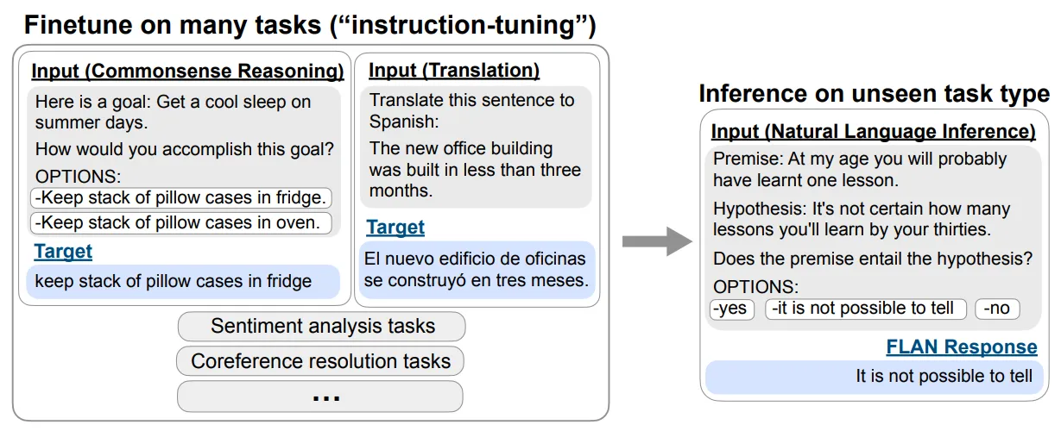
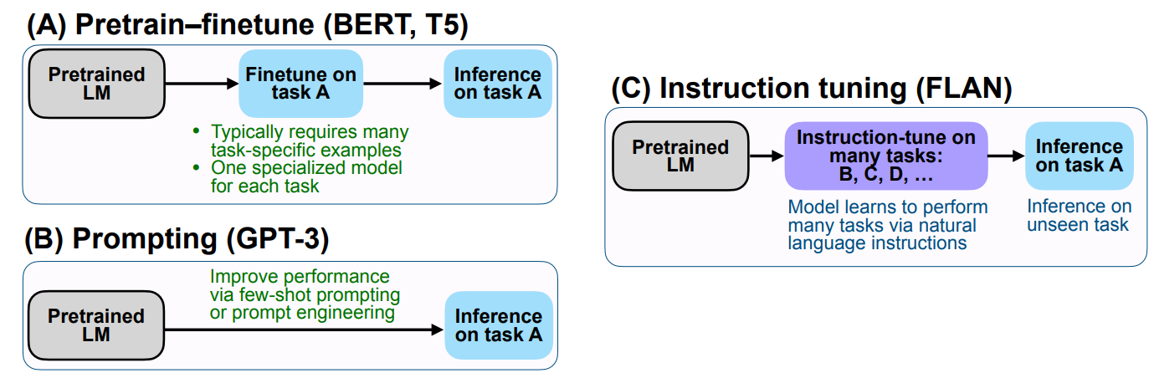
Prompts with Instructions
Unlike open-ended prompts, prompts with instructions guide the model to perform specific tasks or follow certain rules within its response.
Structured Responses: Instruction-based prompts lead to more structured and targeted outputs, adhering to the format or content specified in the instruction.
Wei et al., 2022, Instruction Tuning Vol. 1

Slide 6
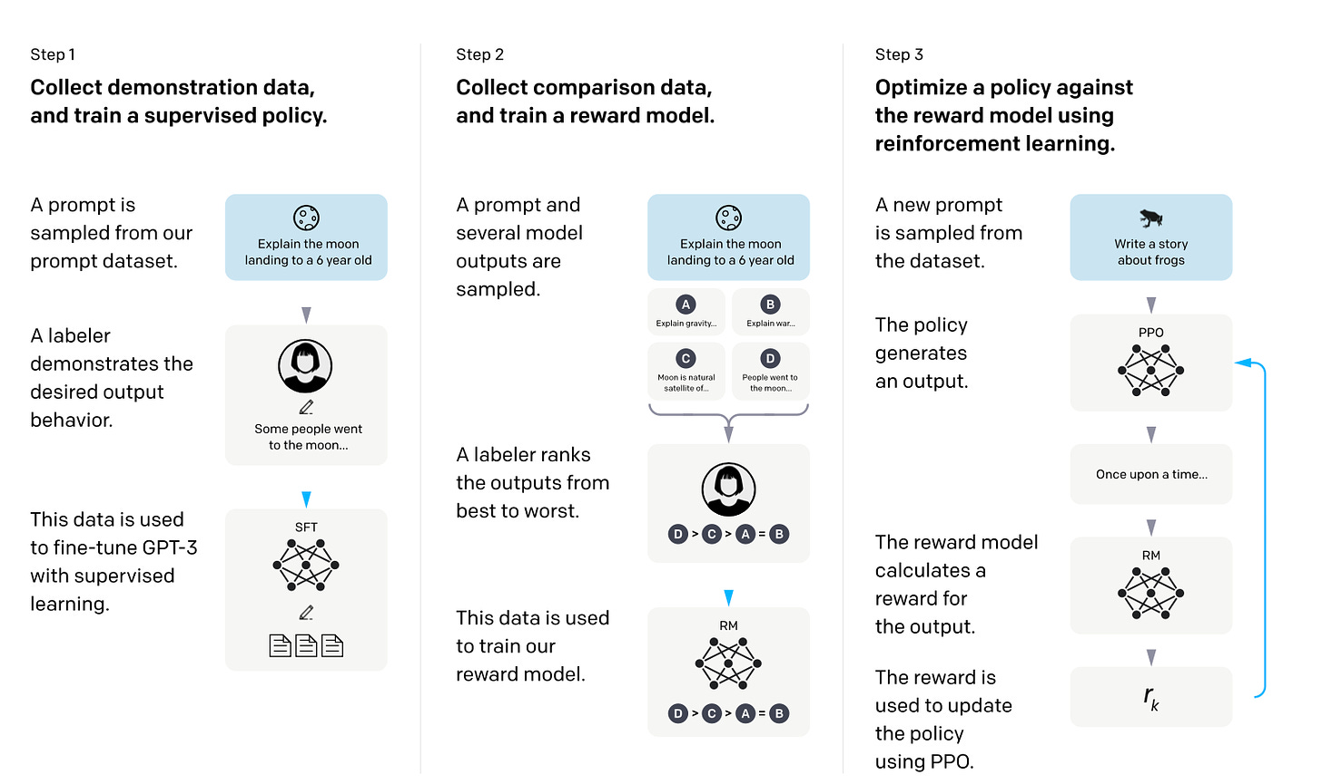
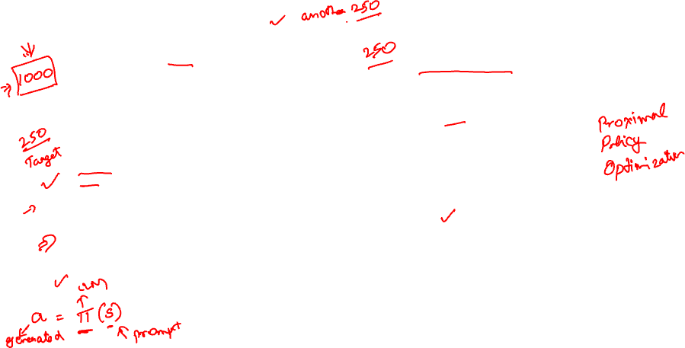
Instruct Fine Tuning via RLHF

Slide 7
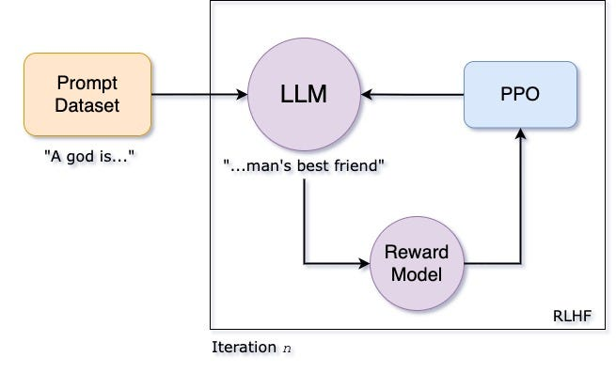

RLHF via Proximal Policy Optimization (PPO)
Source: https://medium.com/@oleglatypov/a-comprehensive-guide-to-proximal-policy-optimization-ppo-in-ai-82edab5db200

Slide 8
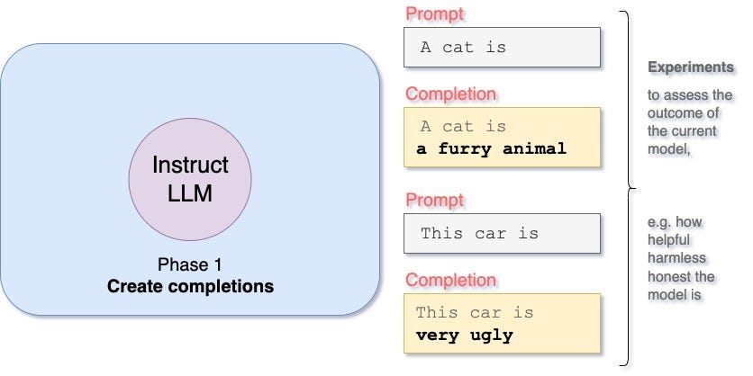
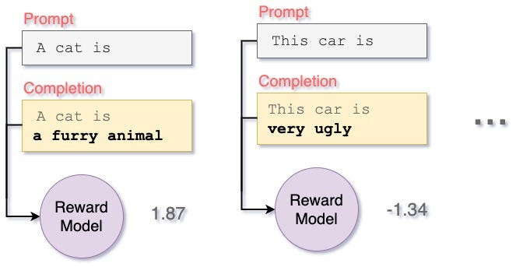
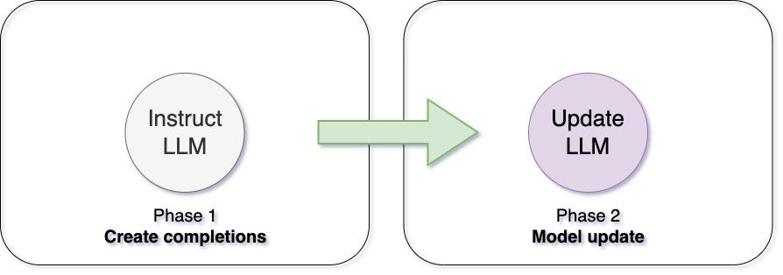
PPO Steps

Slide 9

Sheldon Cooper

Slide 10
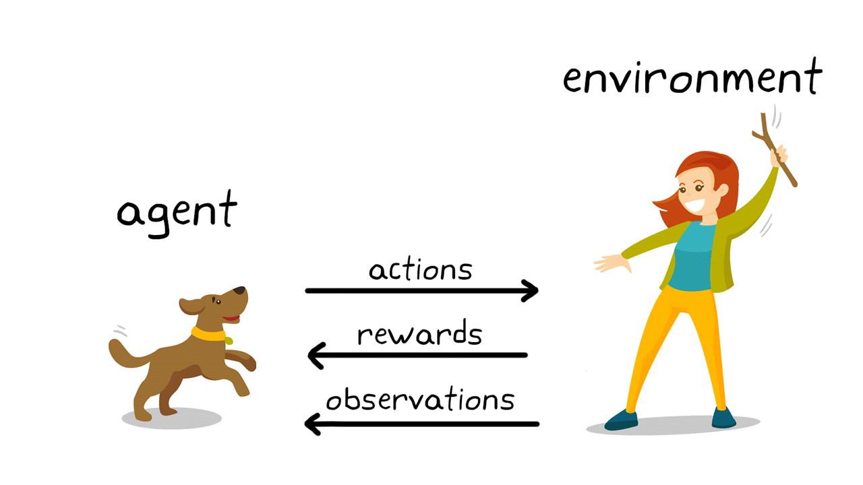

The RL Setting
5 Key Concepts
Agent Environment State (Observation) Action Reward
State s
Agent takes an action a based on the state s for which it receives a reward r
Environment has states. The agent’s a at s changes to s’ after interaction. It also gives a reward
Action a
[www.mathworks.com]
Reward r

Slide 11

Outline for Feb 01
Part 1:
Instruction Tuning
Part 2:
Orchestration
Retrieval Augmented Generation
Part 3:
LLM Guardrails
LLM Agents

Slide 12
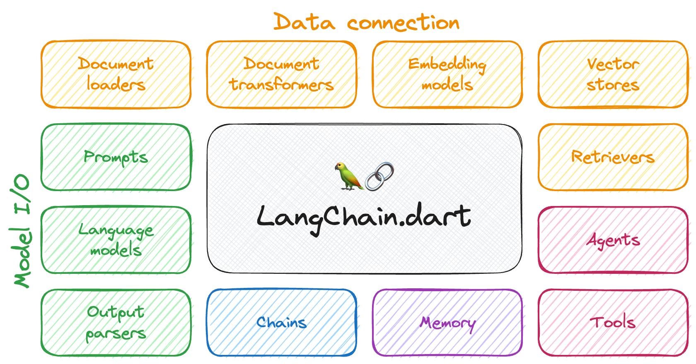
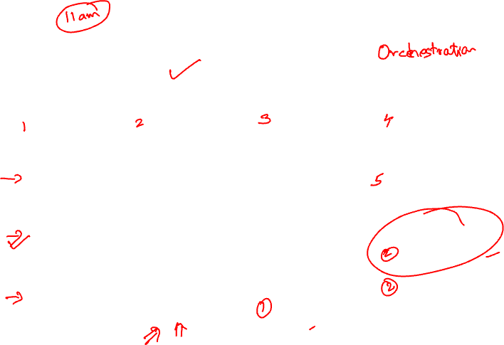
LangChain

Slide 13
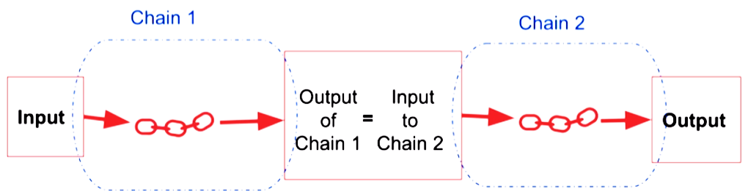
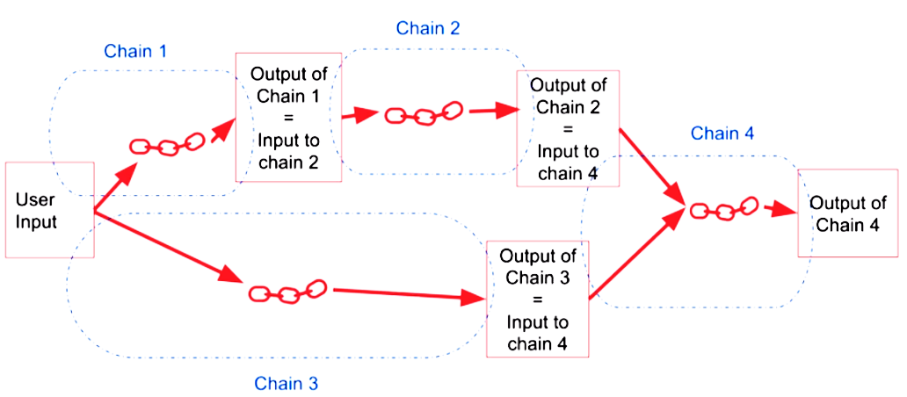

Orchestrating a Solution

Slide 14
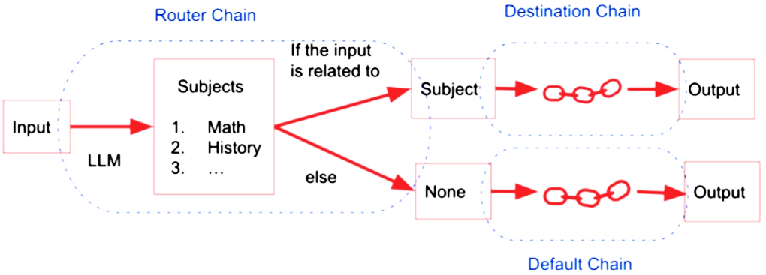
Router Chain

Slide 15
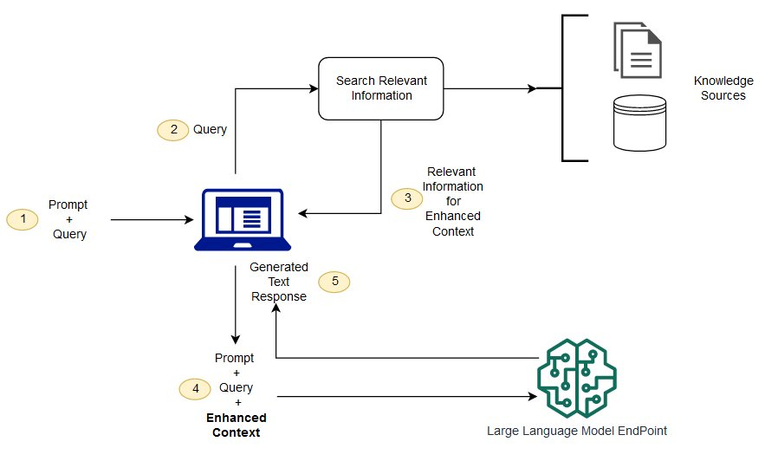


Retrieval Augmented Generation

Slide 16
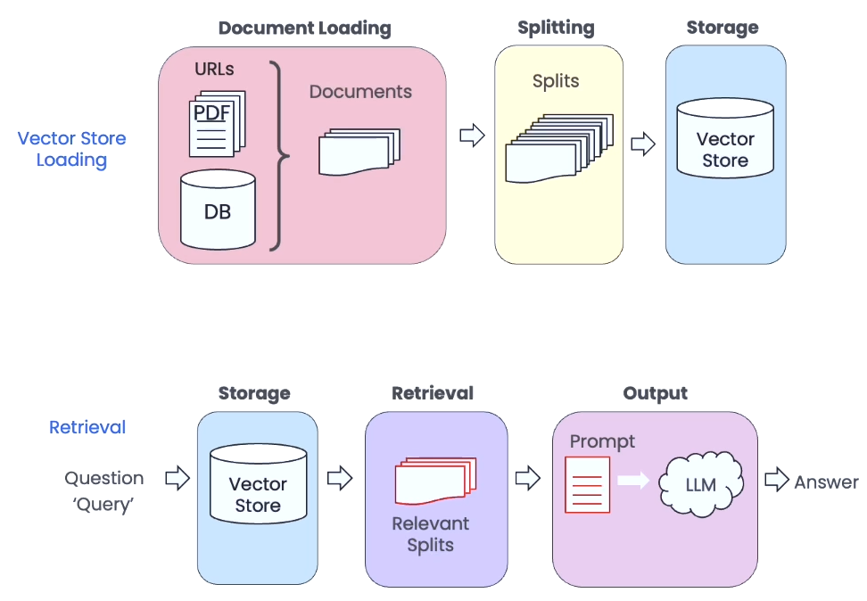

Vector Store and Retrieval

Slide 17
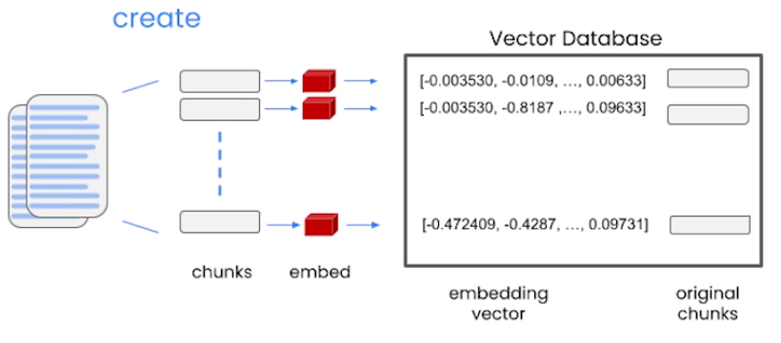
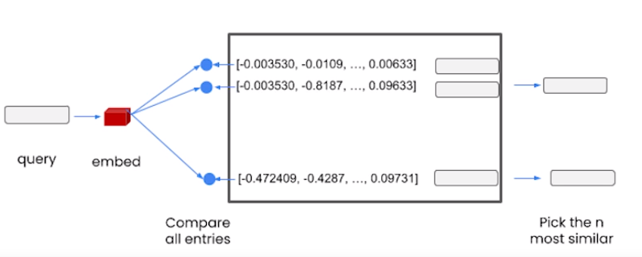

Retrieval in Action
Data is chopped into chunks and embedded in the vector database
When a query comes in, the query embedding is compared to all entities and top similar, yet diverse matches are selected

Slide 18
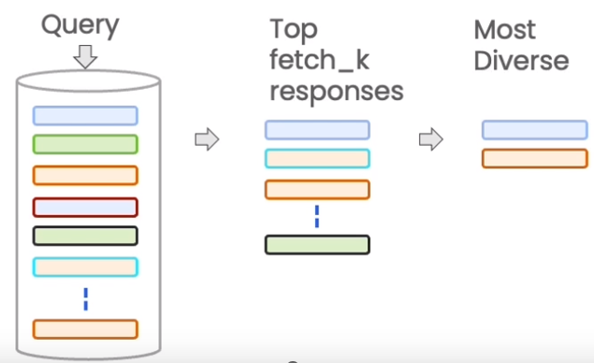

Maximum Marginal Relevance(MMR)

Slide 19
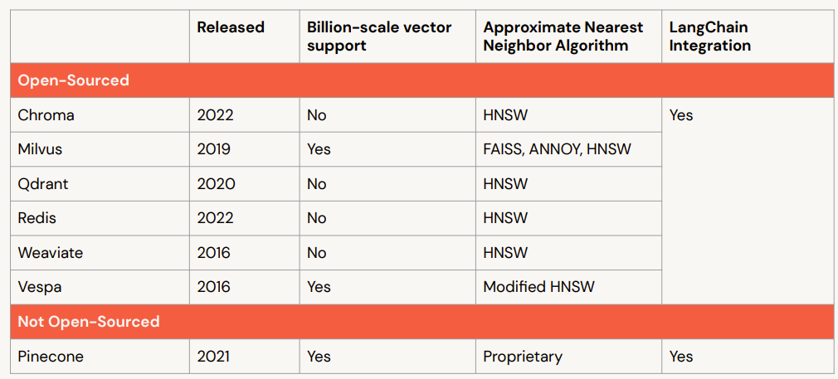

Vector Store Vendors

Slide 20
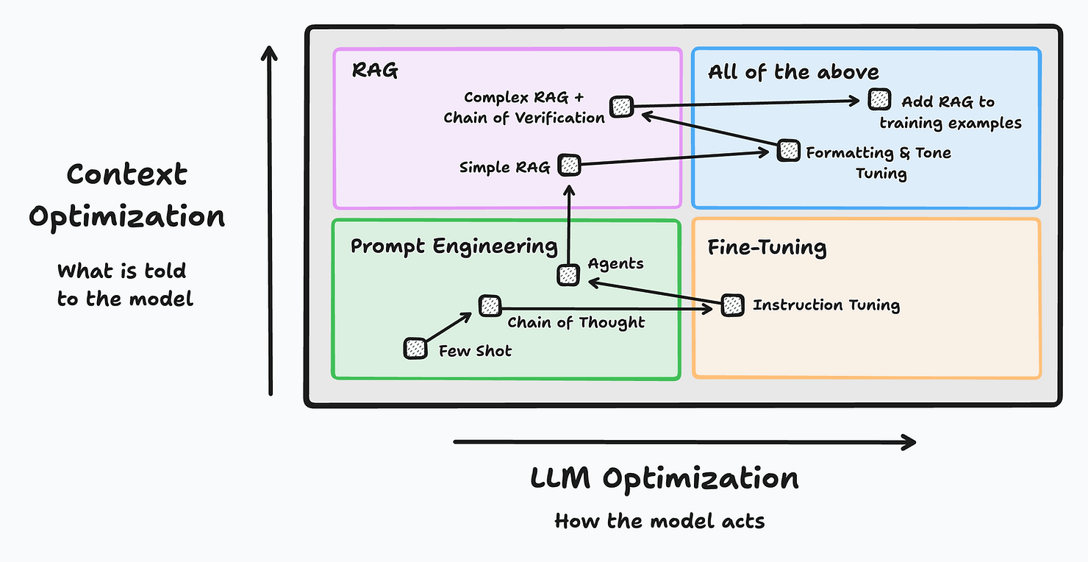

Prompt Engineering -> RAG -> Fine Tuning
Image Credits: https://www.tensorops.ai/post/prompt-eng-vs-rag-vs-fine-tuning-what-do-you-need

Slide 21
Outline for Feb 01
Part 1:
Instruction Tuning
Part 2:
Orchestration
Retrieval Augmented Generation
Part 3:
LLM Guardrails
LLM Agents

Slide 22
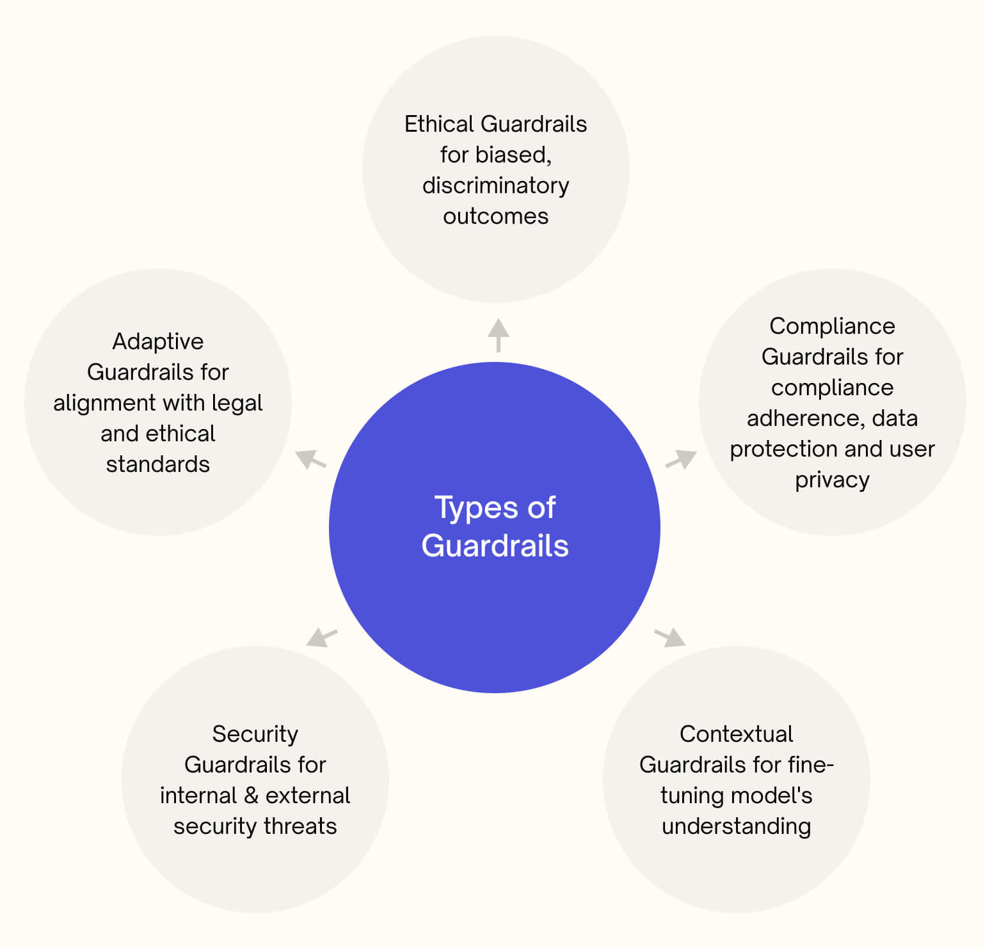
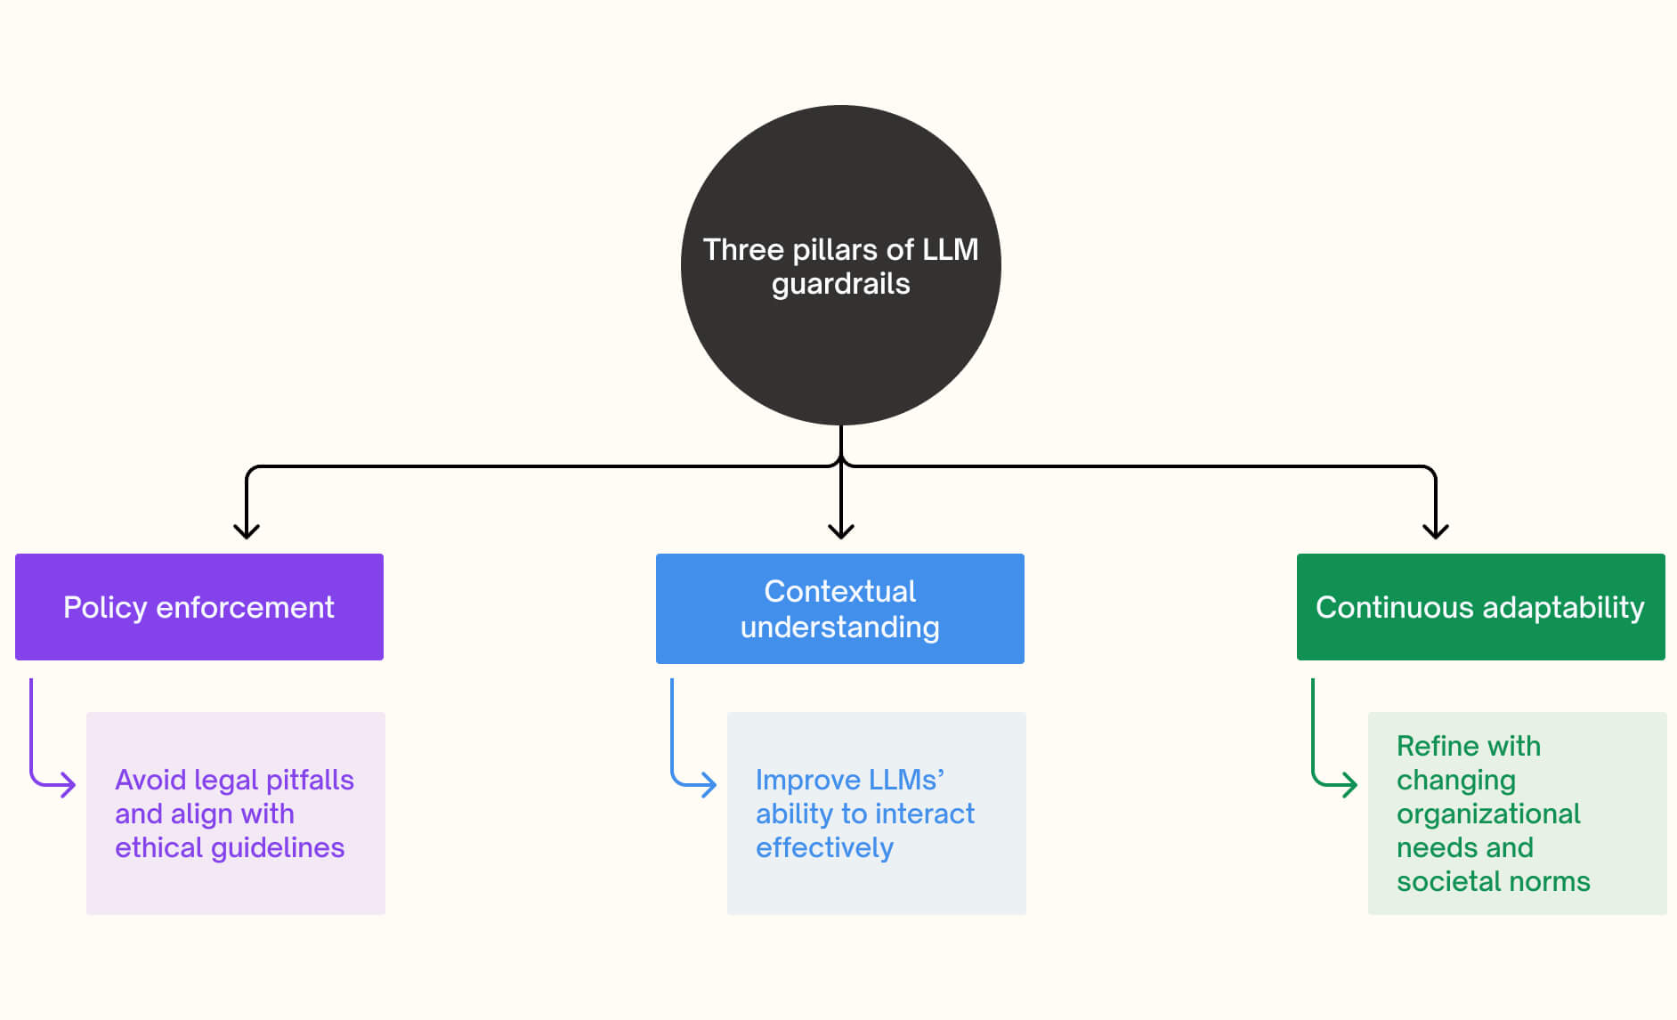

Why LLM Guardrails are Needed?

Slide 23
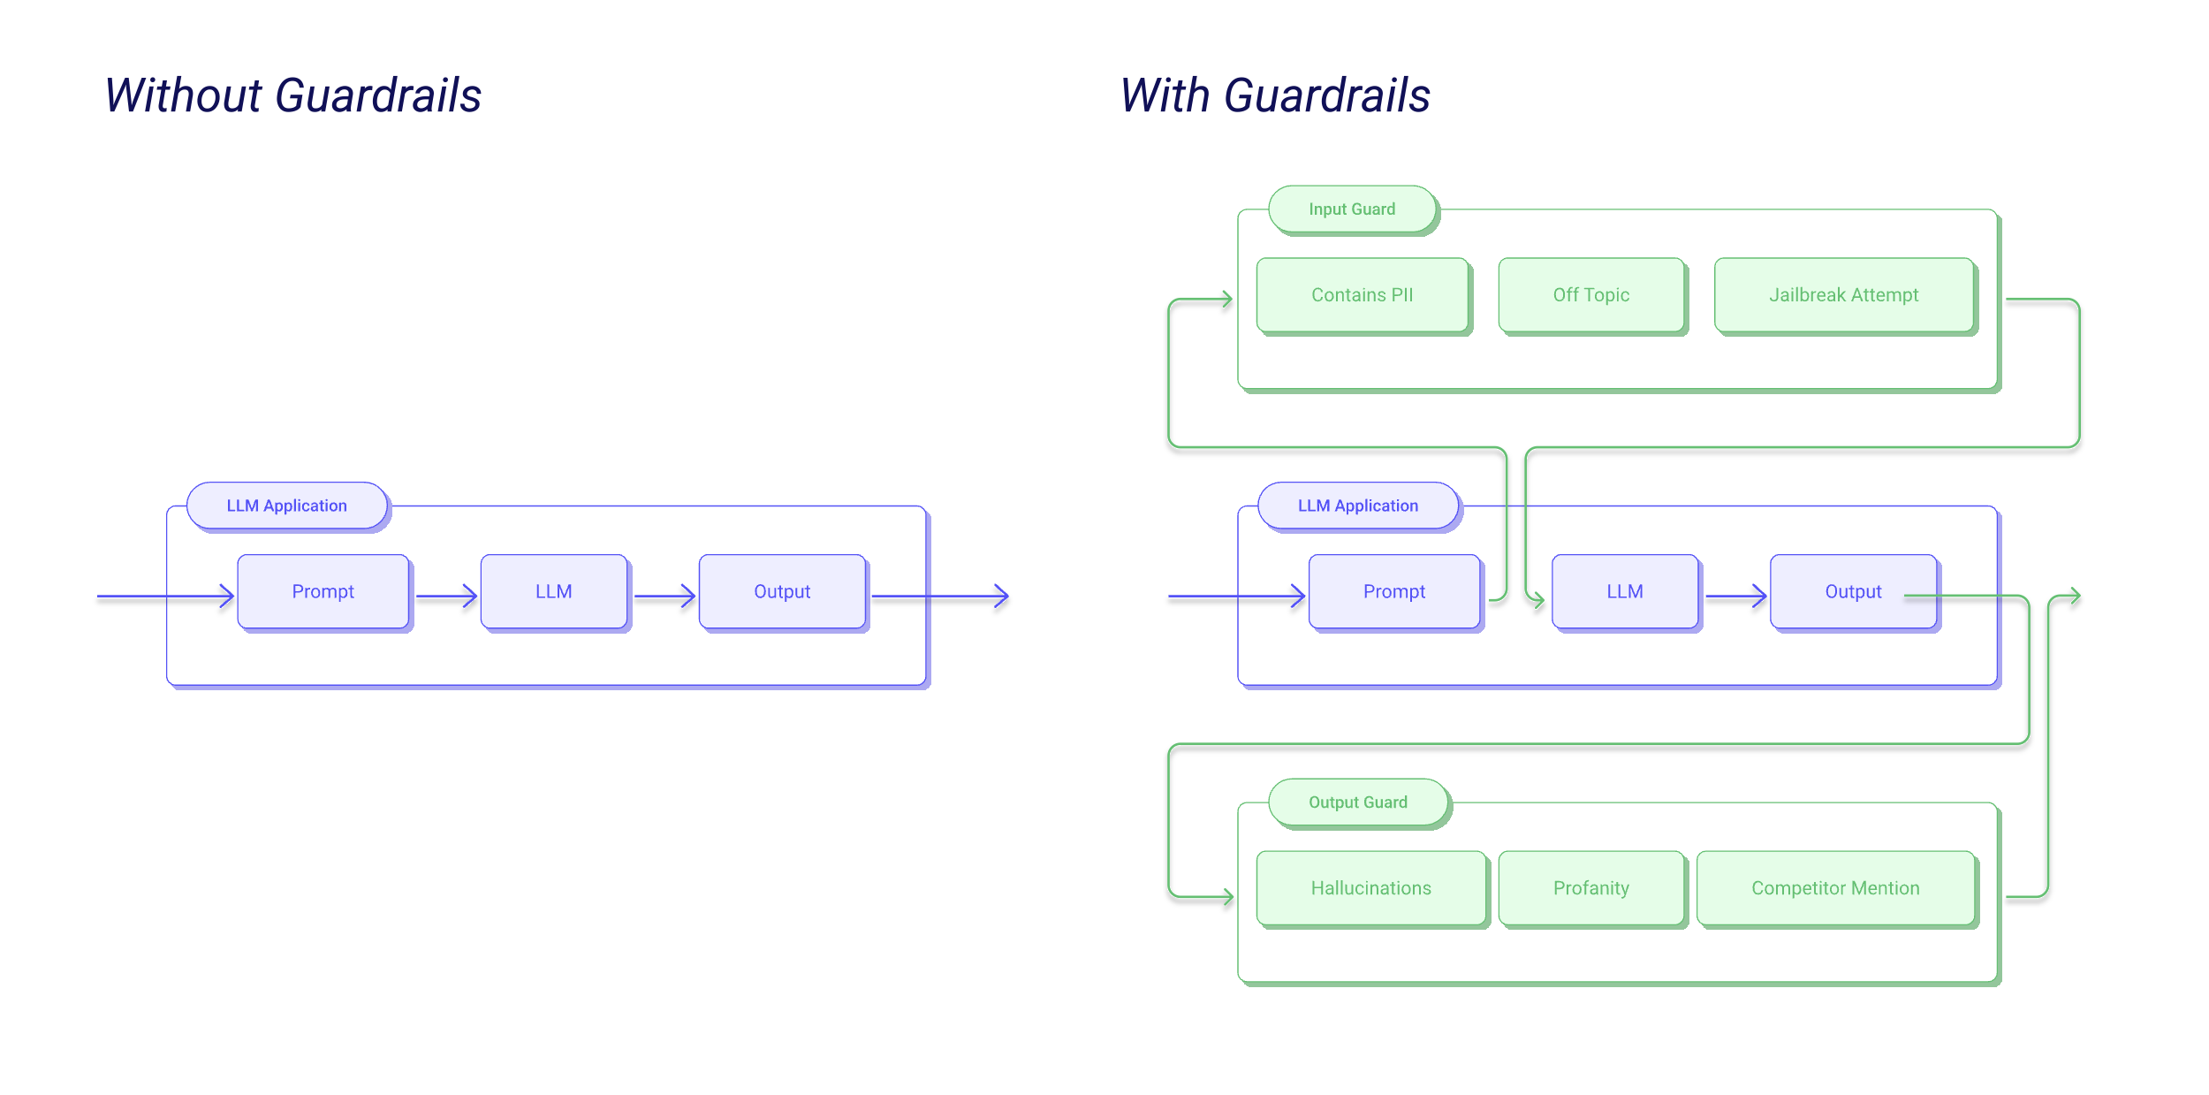
LLM Guardrails

Slide 24
How to Implement Guardrails in your Orchestration?
Use Guardrails AI
https://hub.guardrailsai.com/
https://github.com/guardrails-ai/guardrails?tab=readme-ov-file
OpenAI’s Moderation AI
https://platform.openai.com/docs/guides/moderation
NVIDIA’s NeMo Guardrails
https://github.com/NVIDIA/NeMo-Guardrails

Slide 25
LLM Agents
LLM Agents are advanced AI systems that use LLMs to understand and generate human language.
LLM Agents go beyond simple text generation.
They can maintain the thread of a conversation,
recall previous statements, and
adjust their responses accordingly with different tones and styles.
Diverse Use Cases: customer service, copywriting, data analysis, education, healthcare
Caution: do not understand nuanced human emotions, and are subject to the risk of misinformation, bias, privacy data leaks and toxicity

Slide 26
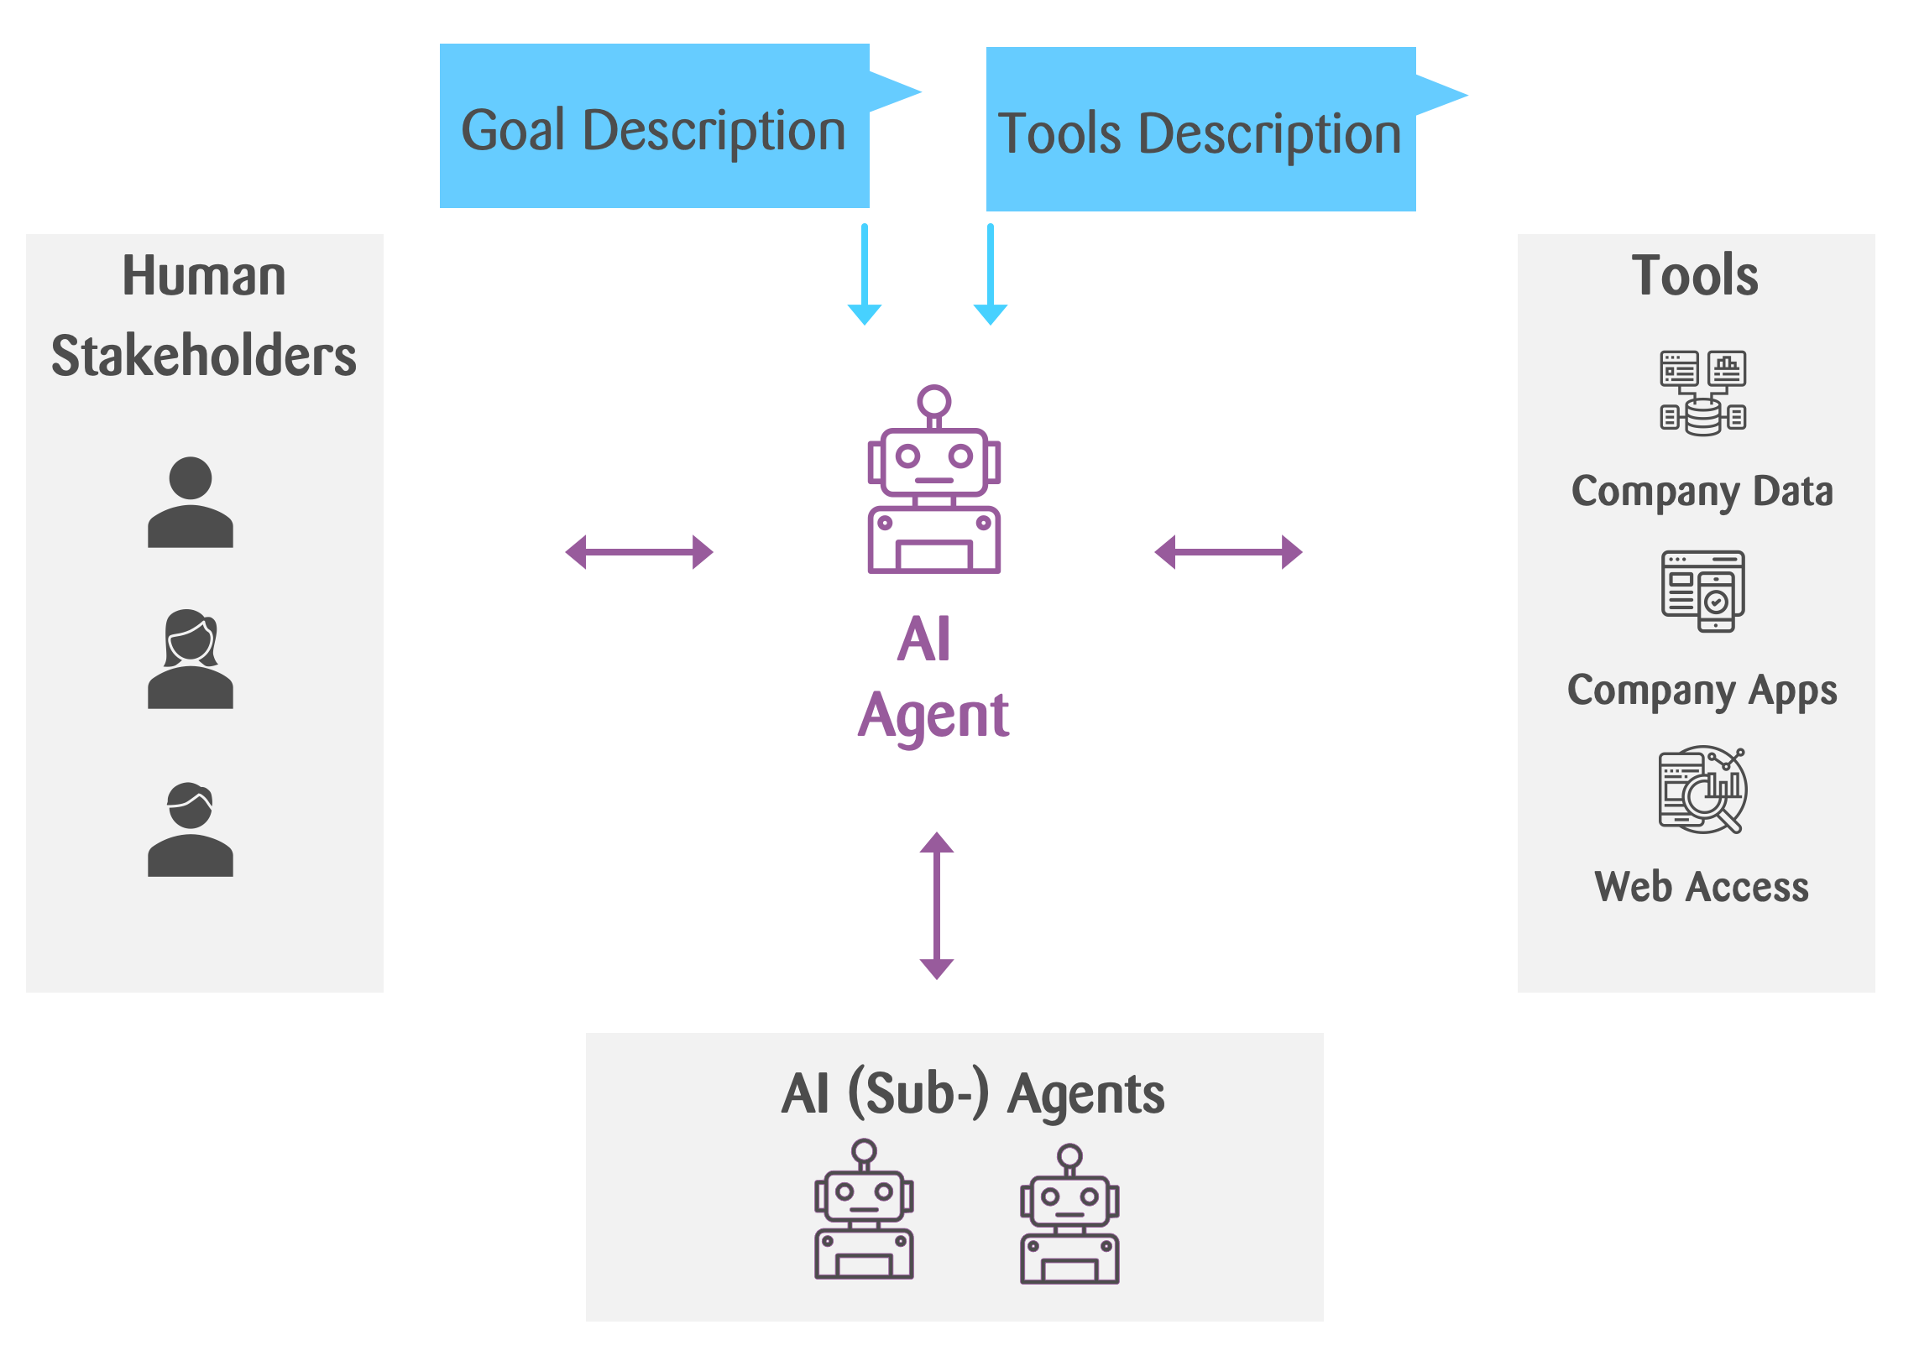

Agentic AI
Agentic AI is a powerful new paradigm for enterprise
Goal of Agentic AI: system that can independently pursue goals, make decisions, and take actions in its domain of expertise.
Key aspects of Agents:
State Awareness
Reactive and Proactive actions – Recollect how Claude chat ends
Access to external tools to get knowledge and/or data
Source: https://www.zuehlke.com/en/insights/agentic-ai-risks-rewards-of-adaptive-ai

Slide 27
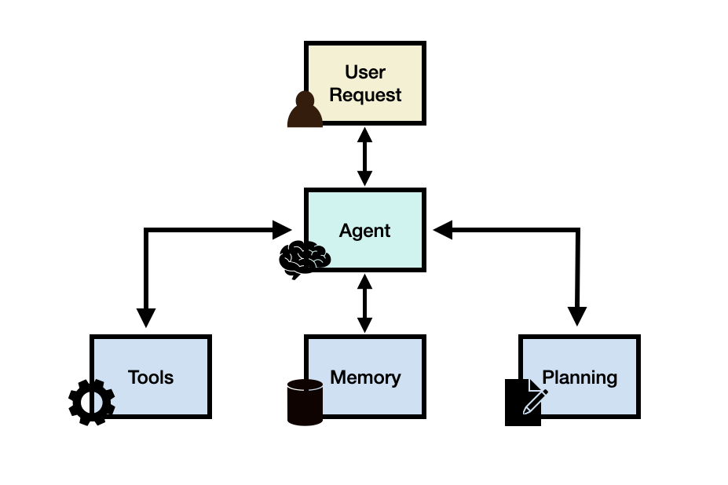
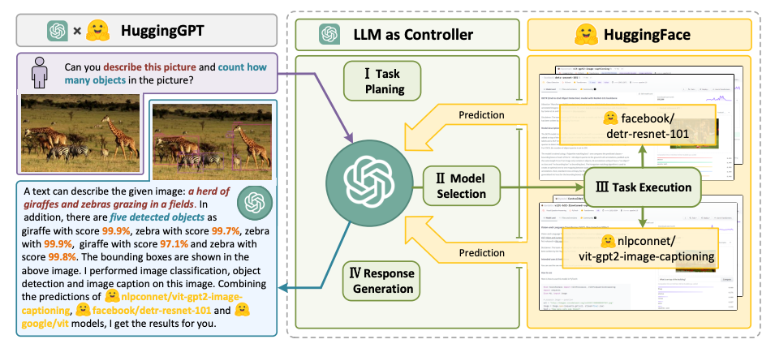
LLM Agent Framework

Slide 28
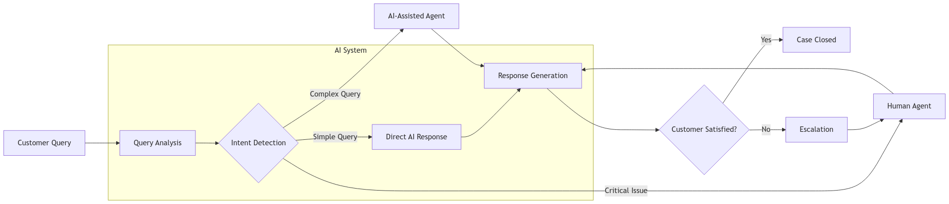

A GenAI Solution for Customer Support
Intent Detection Chain
API Call for AI - Assisted Agent
Guardrails for human-agent interaction
RAG for attaching knowledge base
Text to SQL -> Tools to query databases
Memory Buffers to keep track of history
Default Chain for complex queries – Patch to Human
Feedback Collection

Slide 29
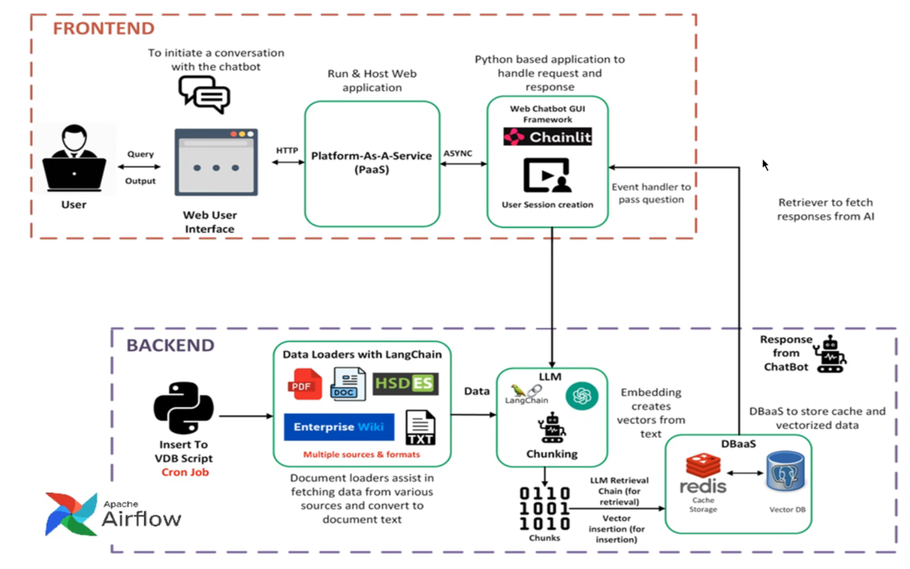
Orchestration Stack (Example)

Slide 30
Conversation Commerce: Today’s Opportunity
Emerging paradigm in customer relationship, engagement and sales
Enables shopping through natural conversations
Combines convenience of messaging with traditional e-commerce
Why It Matters
64% of consumers prefer messaging over calling businesses
Messaging apps have 5B+ monthly active users globally
Higher conversion rates: 3-5x compared to traditional e-commerce
Key Tools & Platforms
Business Messaging: WhatsApp Business API, Facebook Messenger, Apple Business Chat
Chatbot Platforms: Dialogflow (Google), Microsoft Bot Framework, MobileMonkey
Payment Integration

Slide 31
Example
Customer: "Hi, I want to order a cappuccino"
Bot: "Welcome to Third Wave! Hot cappuccino (₹220)? Our Belgian chocolate version is trending in Indiranagar! ✨"
Customer: "Regular hot cappuccino"
Bot: "Regular/Oat/Soy milk? Oat from Goodmylk Co. (+₹60)"
Customer: "Regular milk"
Bot: "HSR Branch 7 for pickup? Add masala cheese toast (₹160)?"
Customer: "Yes HSR 7, no food"
Bot: "Total ₹220. Ready 1:45 PM. GPay/Paytm/UPI? +22 Bean Points! 🌟"
Customer: "GPay"
Bot: "GPay link sent! Barista Priya will have your coffee ready. Here's your QR code ☕"

Slide 32
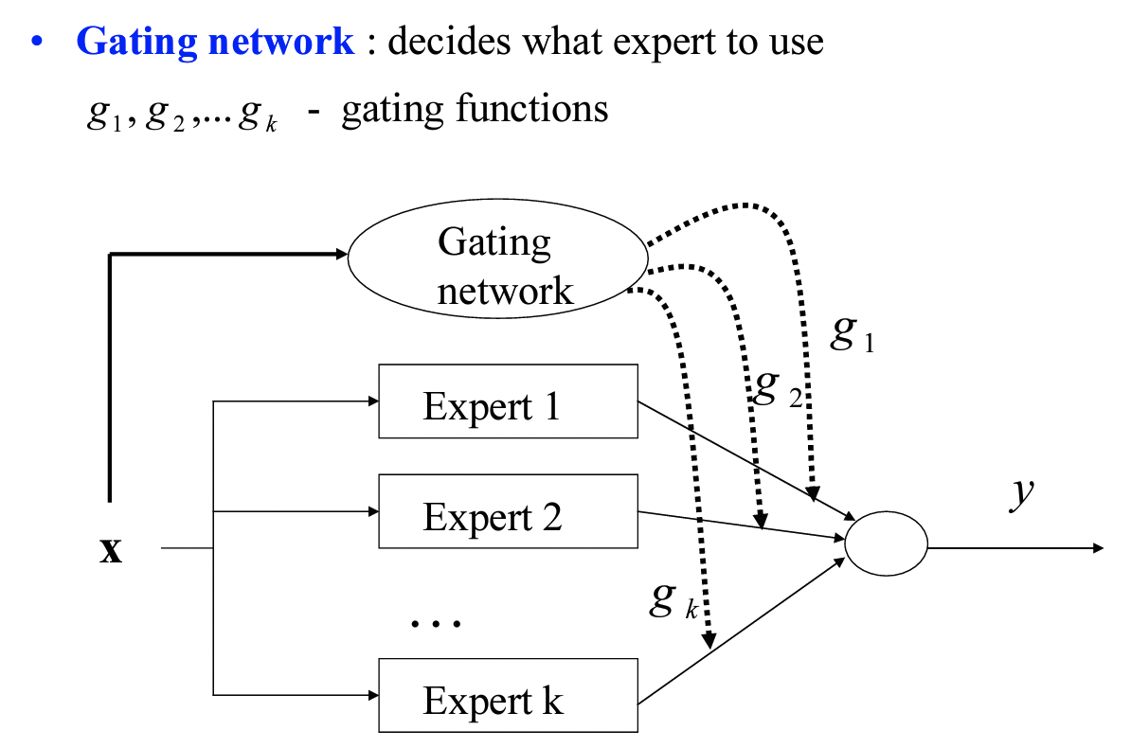
Mixture of Experts Model

